Slide 1

RECAP
Last Session, in 60 Seconds
4 / 15

Slide 2
RECAP
Last Session, in 60 Seconds
One real strategic bet plays out at all three levels: corporate, SBU, functional
Reliance's telecom entry was corporate; Jio pricing was SBU; the network build was functional
Even a single momo cart makes decisions at all three levels
4 / 15

Slide 3
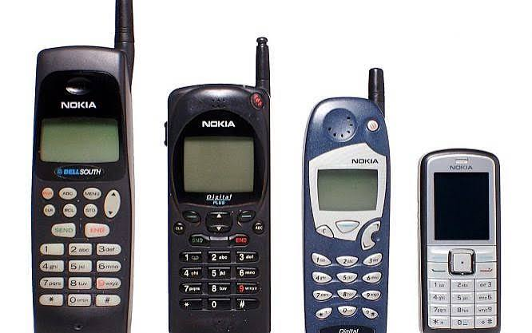
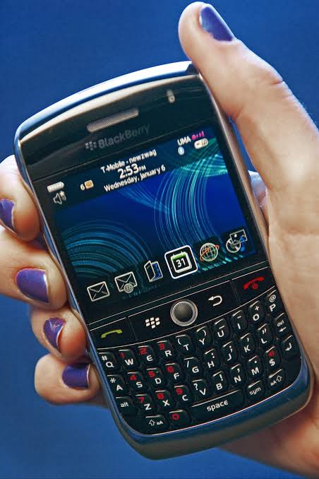
A STORY TO START
The Phone That Ruled India, Then Nearly Vanished
History based on widely documented accounts of Nokia's decline in India and globally (post-2009).
5 / 15

Slide 4
A STORY TO START
The Phone That Ruled India, Then Nearly Vanished
Around 2009
Nokia commands roughly 60% of India's mobile phone market — the default brand in nearly every pocket.
The signal it missed
As Android-powered touchscreen smartphones began reshaping the market, Nokia stayed loyal to its own ageing software instead of reading where customers were clearly heading.
A few years later
Nokia's share collapsed as customers moved to Android phones — including budget Indian brands — and its handset business was eventually sold off entirely.
History based on widely documented accounts of Nokia's decline in India and globally (post-2009).
5 / 15

Slide 5
CORE CONCEPT 1
What Is Environmental Scanning?
Based on: A. Nag, Strategic Management: Analysis, Implementation and Control, Ch. 6.
6 / 15

Slide 6
CORE CONCEPT 1
What Is Environmental Scanning?
The ongoing habit of watching for signals of change in customers, competitors, technology, and the wider world before those changes force your hand.
Nokia's signal was there for years
Touchscreens, app ecosystems, and Android were all visible well before Nokia's market share actually collapsed. Scanning isn't about predicting the unpredictable — it's about actually noticing what's already visible.
Based on: A. Nag, Strategic Management: Analysis, Implementation and Control, Ch. 6.
6 / 15

Slide 7
TWO DIRECTIONS TO LOOK
Scanning Outward vs. Scanning Inward
Outward Scanning | Inward Scanning
What are customers, competitors and technology doing? | What can we actually afford, staff and support well?
Nokia should have watched Android's rise closely | Nokia should have honestly assessed its own software gap
Real scanning always looks both ways at once.
7 / 15

Slide 8
CORE CONCEPT 2
Forecasting?

Slide 9
CORE CONCEPT 2
What Is Forecasting?
Turning the signals you've scanned into an actual, usable guess about the future.
Scanning without forecasting just leaves you with a pile of interesting facts. Forecasting forces you to commit to what those facts likely mean for tomorrow.
No forecast is ever perfectly right the goal is a reasoned, honest guess, not a guarantee.
Based on: A. Nag, Strategic Management: Analysis, Implementation and Control, Ch. 6.
8 / 15

Slide 10
MAKING IT PRACTICAL
Three Simple Ways to Forecast
Trend extrapolation
Expert judgment
Scenario thinking
Based on: A. Nag, Strategic Management: Analysis, Implementation and Control, Ch. 6.
9 / 15

Slide 11
MAKING IT PRACTICAL
Three Simple Ways to Forecast
Trend extrapolation
If a pattern has held for years, assume it broadly continues — unless you see a real reason it won't
Expert judgment
Ask people who've watched this space for years what they honestly expect
Scenario thinking
Sketch a best case, a worst case, and a most-likely case — then plan for more than one
Based on: A. Nag, Strategic Management: Analysis, Implementation and Control, Ch. 6.
9 / 15

Slide 12
BACK TO NOKIA
What Real Scanning Would Have Shown
Outward signal missed
Android adoption climbing fast among developers and rival phone makers
Inward signal ignored
Its own software (Symbian) was falling further behind every year
A better forecast
“If this trend continues, touchscreens and app stores become the default within a few years”
History based on widely documented accounts of Nokia's decline.
10 / 15

Slide 13
BACK TO PRIYA'S MOMOS
Scanning Her Own Market
Outward: Two new food-delivery apps have started covering her college's neighbourhood this year.
Inward: She's never tracked how many of her customers actually order through those apps versus walking up to her cart.
Her forecast: if delivery apps keep growing, cart-only sales may plateau within a year — worth watching closely, not ignoring.
“Priya's Momos” is a fictional business created for classroom illustration only.
11 / 15

Slide 14
CLASS DISCUSSION · 5 MINUTES
What Signals Are You Missing?
Think about a business you know well — a family shop, a college canteen, anything.
• What outward signal might they be ignoring right now?
• What inward weakness might they be avoiding looking at honestly?
• If current trends continue for 2 more years, what happens to them?
12 / 15

Slide 15
WHY THIS MATTERS
Why This Matters for a Founder
1
Small businesses can't afford Nokia's mistake there's no cushion of size to survive it
2
Scanning is cheap; ignoring visible change is expensive later
3
A simple weekly habit of asking “what changed this week?” beats an annual deep-dive nobody does
13 / 15

Slide 16
SUMMARY
Key Takeaways from Today
Environmental scanning means watching for signals of change before they force your hand
Scan both outward (the world) and inward (your own capabilities) at once
Forecasting turns scanned signals into a usable, honest guess about what's coming
Nokia's signals were visible for years the failure was in not acting on them
14 / 15

Slide 17
Term of the day
Fabian Strategy

Slide 18
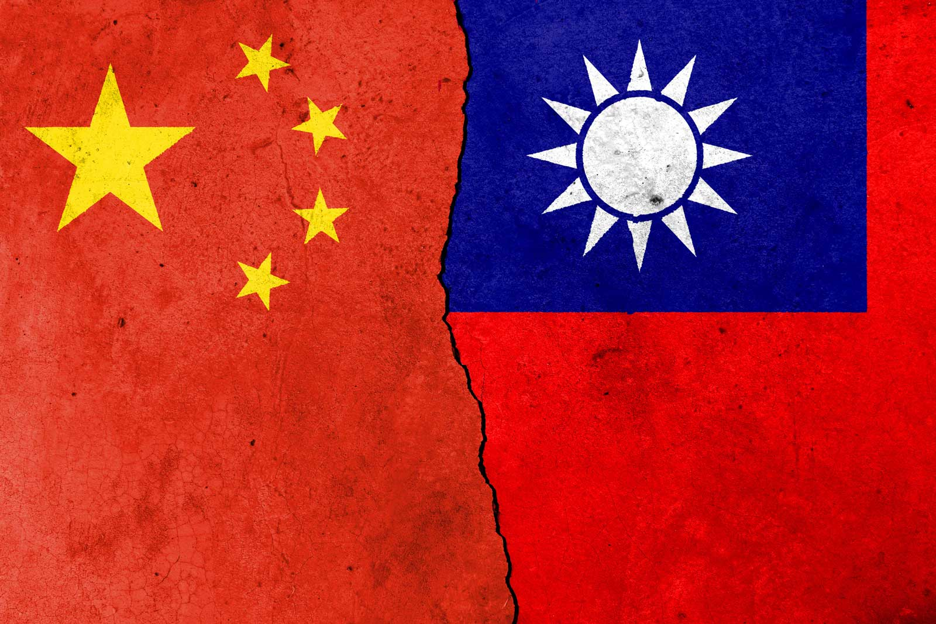
Term of the day
Fabian Strategy

Slide 19
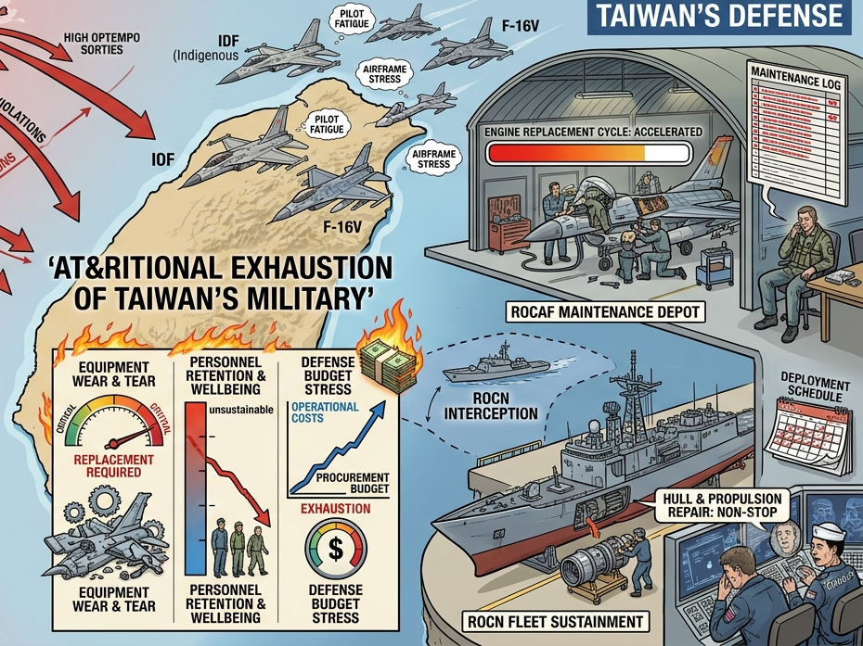
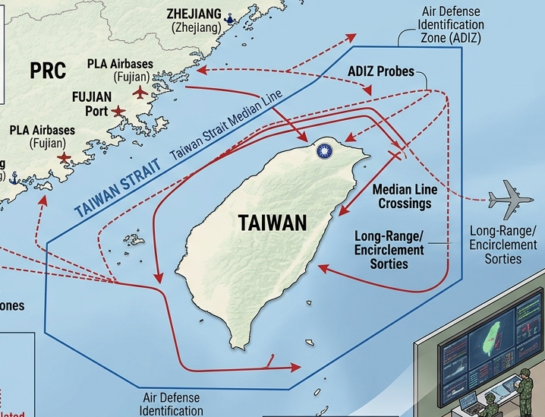
Term of the day
Fabian Strategy
Gray-zone warfare

Slide 20
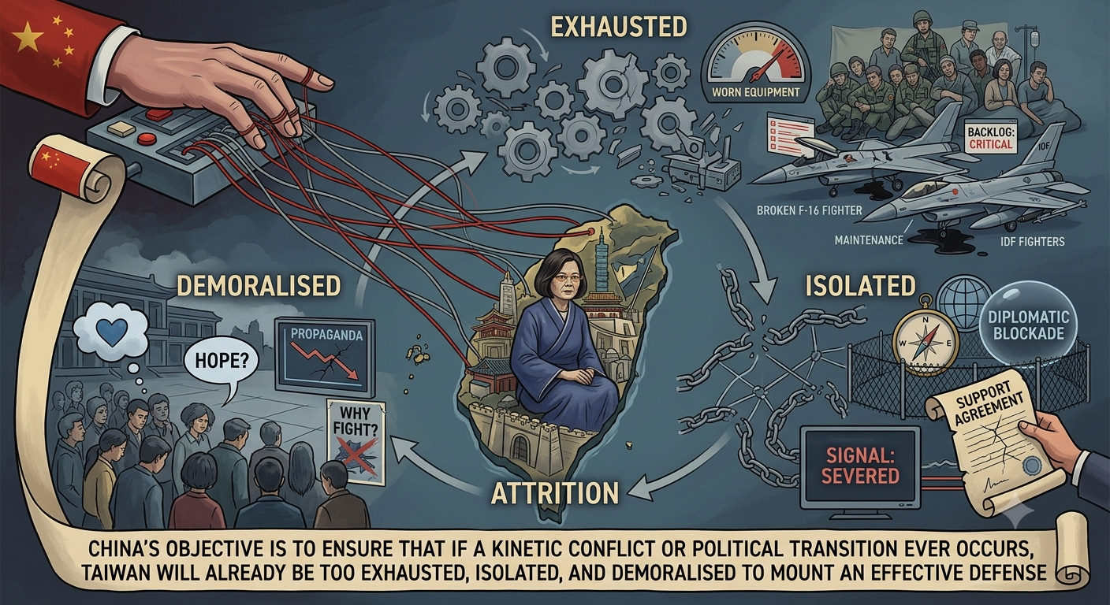
Term of the day
Fabian Strategy

Slide 21
Term of the day
Fabian Strategy
Where a side avoids direct, large battles and instead wears down an enemy through a slow war of attrition, minor skirmishes, and supply disruption

Slide 22
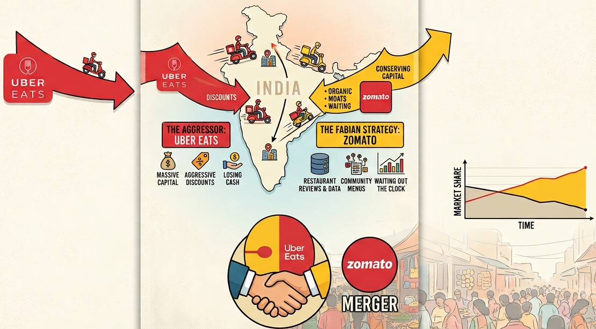
Term of the day
Fabian Strategy

